Slide 1
The Battle of Neighborhoods
Hossam Asaad
.
.
.
Finding best place to open an indian restaurant in New York City

Slide 2
Contents:
Contents………………………………………………………………..2 Introduction…………………………………………………………….3 Business problem……………………………………………………..3 Data .…………………………………………………………………..3 Methodology…………………………………………………………...4 Plotting……………………………………………………...………….9 Discussion…………………………………………………...………...9 Conclusion……………………………………………………....……10

Slide 3
Introduction:
New York is one of the biggest cities in the United States, also New York is the most populous city in the United States.it has a population of 18.8 million. NYC has five districts: the Bronx, Brooklyn, Manhattan, Queens and Staten Island each with dozens of neighborhoods lending their own local flavor.
Business Problem:
Our client is an Indian investor who wants to open a new restaurant in NYC. he has approached us to study the market and suggest a location in one of the neighbourhoods which would be best for a new indian restaurant. Our main objectives of this project would be to extract and analyse right data about various neighbourhoods of Cairo using various data science techniques and suggest to our client a fitting location for his pharmacy.
Data:
We will use :
Geographical coordinates of the neighbourhoods.[link]
Venue data from FourSquare. [link]

Slide 4
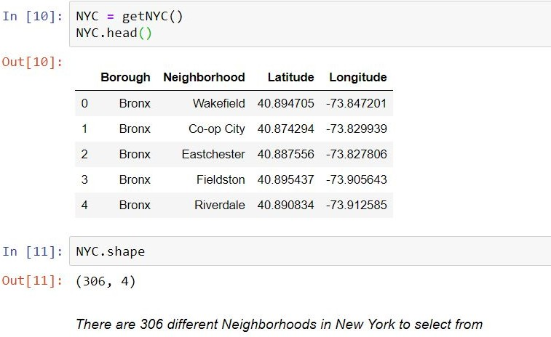
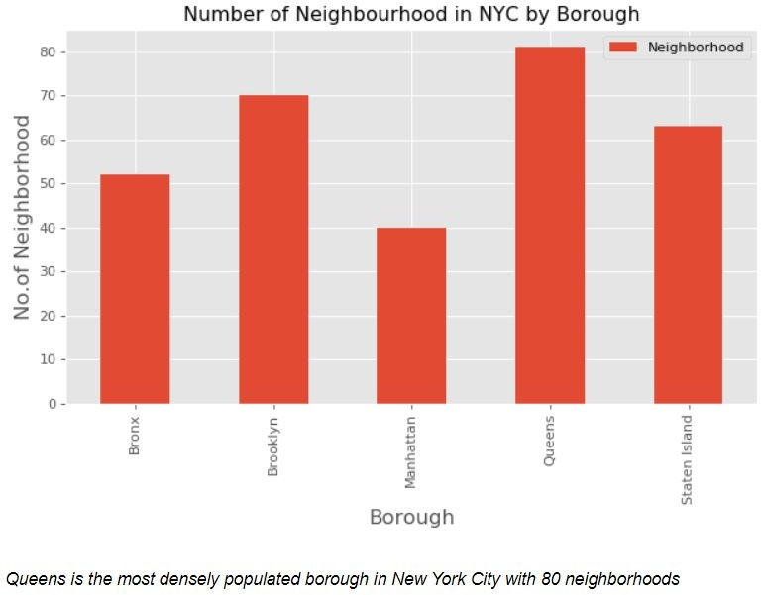
Methodology:
1. First step we will load NYC Data
2. Get no. of neighbourhood in each borough

Slide 5
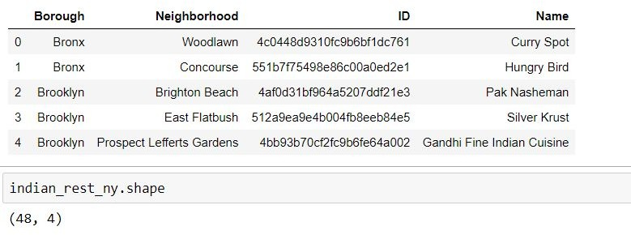
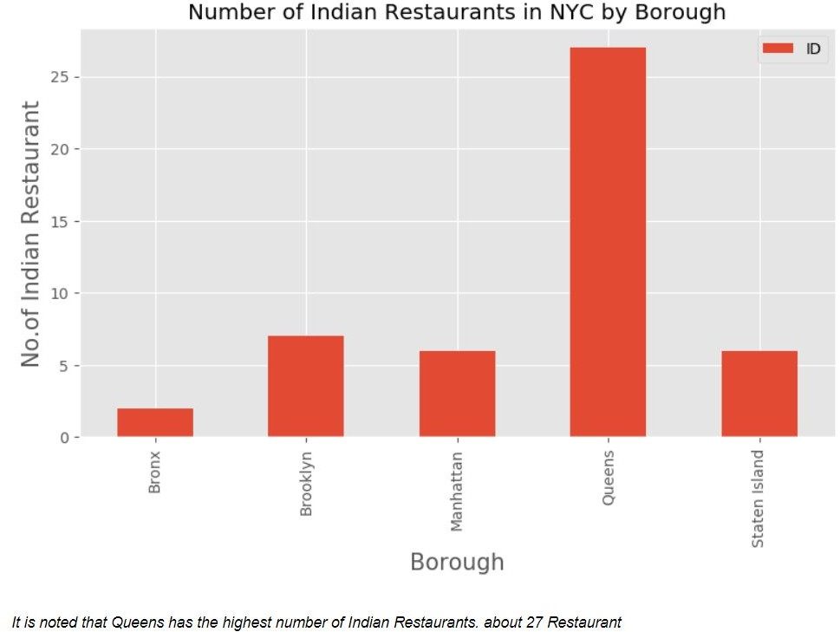
3. Prepare neighborhood list that contains indian restaurant
4. Get Number of Indian Restaurants in NYC by Borough

Slide 6
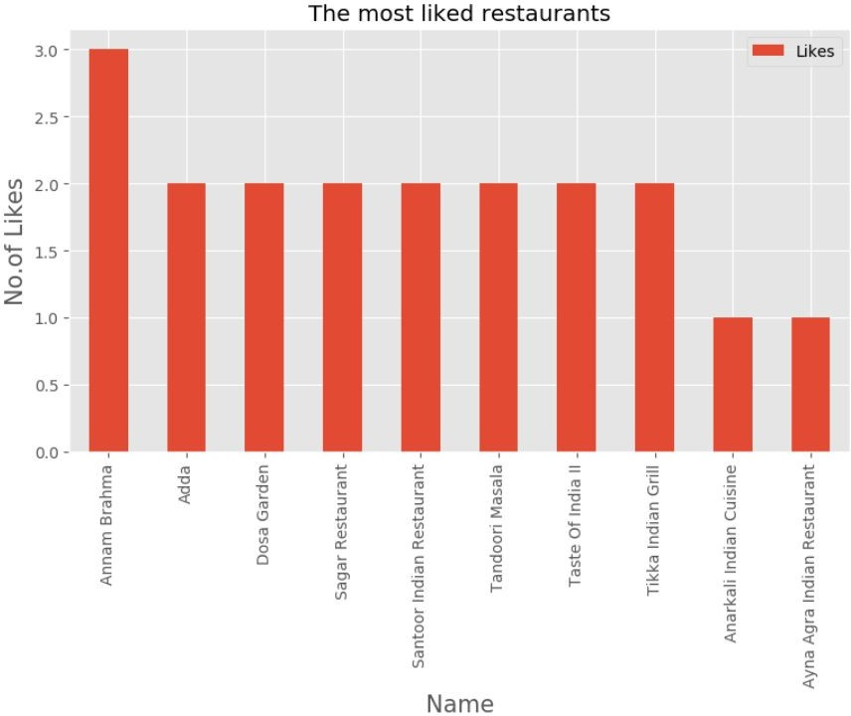
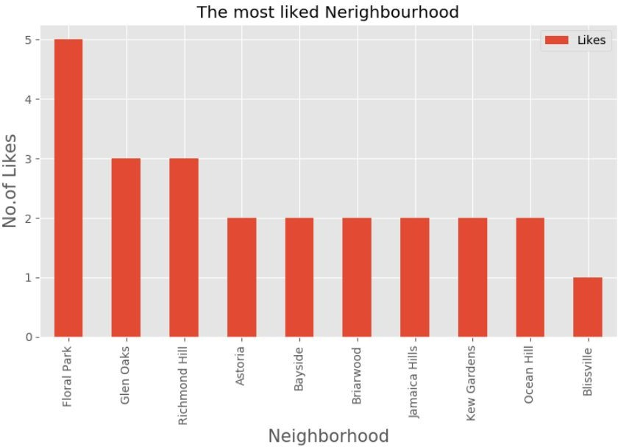
5. Some Investigation to the data

Slide 7
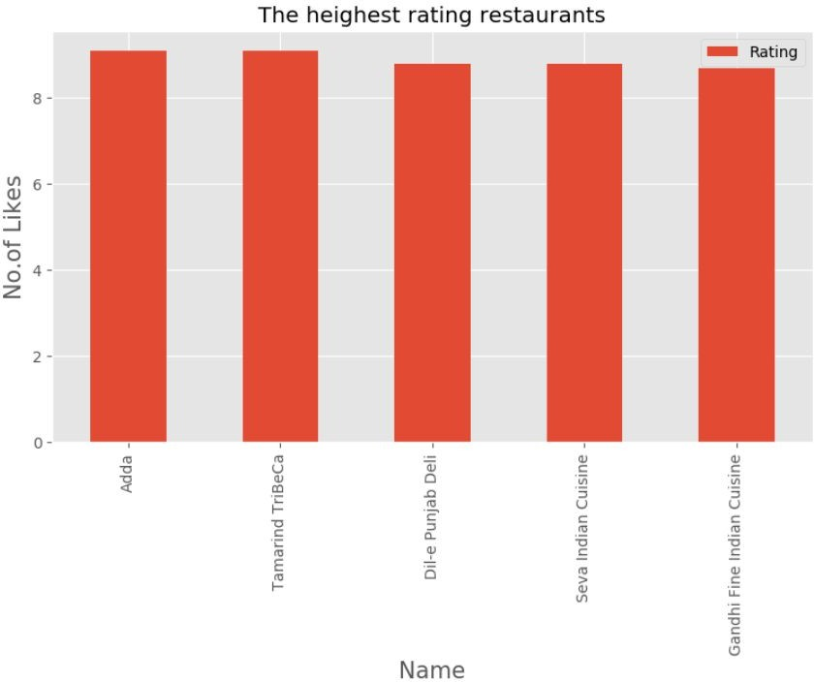
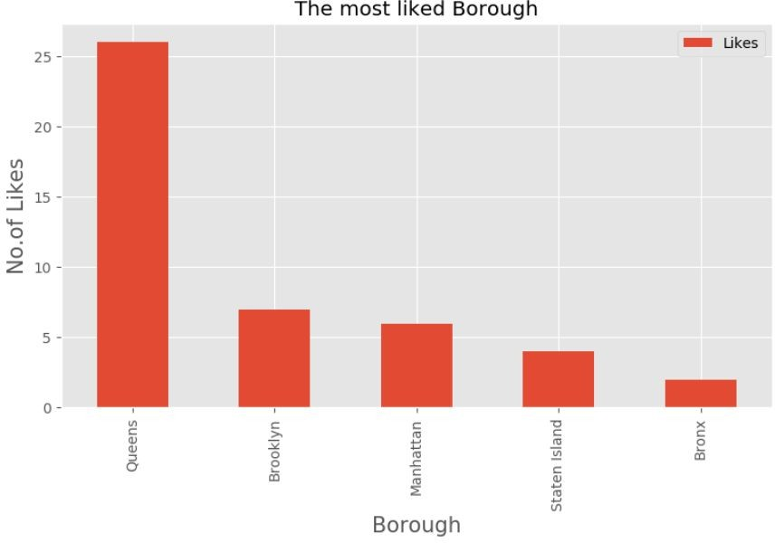

Slide 8
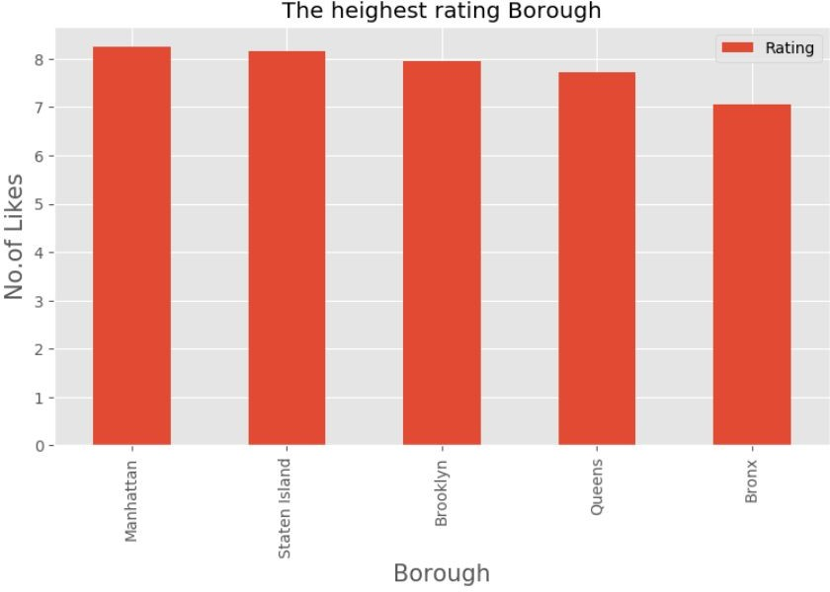

Slide 9
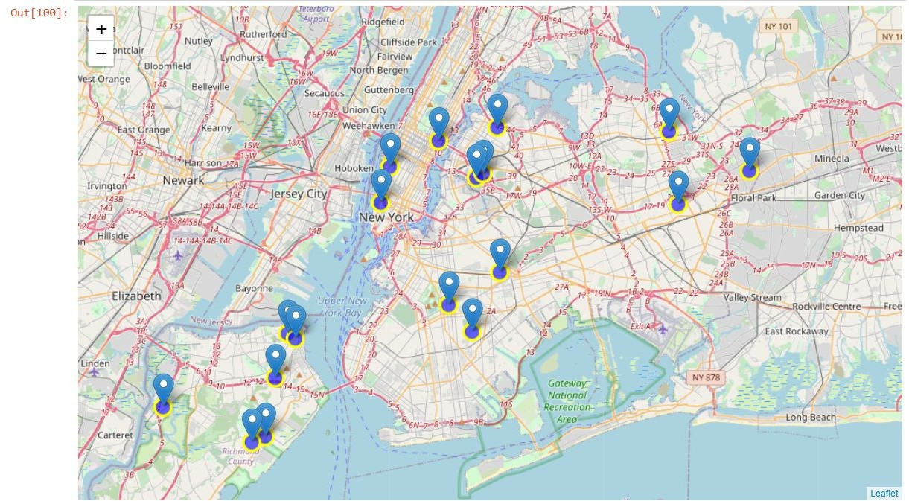
Plotting the map to highest rating neighbourhood
Discussion and Results:
Our analysis show that there is a lot of indian resteraunts in New York, some of NYC boroughs have more restaurants than others, ‘Queens’ has the most indian restaurants, ‘Annam Brahma’ the most
liked restaurants, ‘Floral Park’ is the most Liked Neighbourhood, ‘Adda’ has the highest rating,
‘Manhattan’ borough has the highest rating.

Slide 10
Conclusion:
Midtown or Tribeca in Manhattan would be the best choice to start a restaurant given that
it is the third most populous urban area in New York City (NYC).
it has a population density of 27,826 people per square km, highest of any borough in the United States.
it has some of the top rated Indian restaurants located in that area
It has the second highest Asian ethnic minority population in NYC.

